Slide 1
Digital Portfolio
STUDENT NAME: PAUL ATHISAYAM J
REGISTER NO AND NMID: 2422k175 & FE7FC3851684914ABE7459DD35AE475B
DEPARTMENT: Bsc.COMPUTER SCIENCE
COLLEGE: BISHOP APPASAMY COLLEGE OF ARTS AND SCIENCE/ BHARATHIAR UNIVERSITY [BRU3G]

Slide 2
PROJECT TITLE
MY DIGITAL PORTFOLIO

Slide 3


AGENDA
Problem Statement
Project Overview
End Users
Tools and Technologies
Portfolio design and Layout
Features and Functionality
Results and Screenshots
Conclusion
Github Link
3/21/2024 Annual Review

Slide 4

PROBLEM STATEMENT
•Lack of a cohesive online showcase for logo design work
•Existing portfolios often use dark
themes that don’t align with a bright,
vibrant brand identity
•Limited interactivity and feedback features hinder client engagement
•Inconsistent responsiveness across devices leads to poor mobile experience

Slide 5

PROJECT OVERVIEW
•Develop a clean, light-themed portfolio website for a creative logo designer
•Showcase three signature logo projects with images and descriptive overlays
•Present “About Me,” services, and contact form in a single-page layout
•Implement smooth scrolling navigation and animated stats for a modern feel •Ensure fully responsive design for desktop and mobile viewers

Slide 6

WHO ARE THE END USERS?
• Small business owners seeking a professional logo designer
• Marketing agencies evaluating external creative partners
• Individual entrepreneurs building brand identity from scratch

Slide 7

TOOLS AND TECHNIQUES
•HTML5 for semantic, accessible page structure
•CSS3 (Grid & Flexbox) for flexible, responsive layouts
•JavaScript for smooth scroll, form validation, and stat animations
•DaVinci Resolve–style color gradients implemented via CSS custom properties

Slide 8
POTFOLIO DESIGN AND LAYOUT
• Hero section with name, title, tagline, and animated experience counter
•“About Me” area featuring profile photo, intro text, and skill tags
• Three-column portfolio gallery with hover overlays for project details
• Services section using icon-driven cards for quick scannability
• Contact section combining email link, location info, and inquiry form
8

Slide 9
FEATURES AND FUNCTIONALITY
• Smooth scroll navigation anchored to each section
• Animated counting effect: Years Experience, Logos Created, Client Satisfaction
• Responsive image gallery with scale-on-hover and overlay fade-in
• Client inquiry form with front-end validation and toast notifications
• Mobile menu toggle ensures easy navigation on smaller screens
• Subtle hover and transition effects unify the interactive experience

Slide 10
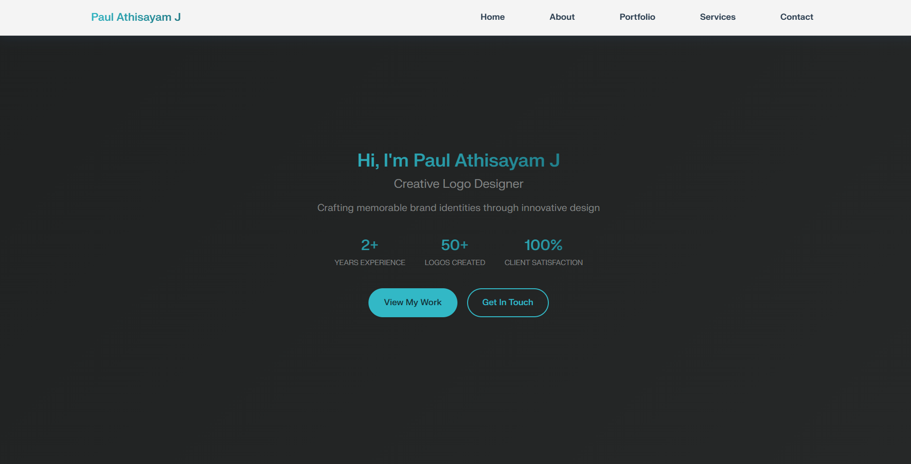
RESULTS AND SCREENSHOTS
• Successfully created a professional logo designer portfolio website
• Enhanced online presence with modern, responsive design across all devices
• Effectively showcased three signature logo projects with interactive hover effects
• Delivered functional contact system with form validation and user notifications
10

Slide 11
CONCLUSION
• Achieved a bright, professional portfolio that reflects brand personality
• Enhanced user engagement through animations and smooth interactions
• Demonstrated full responsiveness without external libraries
• Streamlined client communication via embedded contact form
• Provides a scalable template for future project additions
11

Slide 12
GitHub Link

